Slide 1
Key generation system (v0.0.0)

Slide 2
Shamir’s Secret Sharing
(K, N) threshold scheme
S is the secret that we wish to encode.
It is divided into N parts: S1, S2, S3, …., Sn.
After dividing it, a number K is chosen by the user in order to decrypt the parts and find the original secret.
It is chosen in such a way that if we know less than K parts, then we will not be able to find the secret S (i.e.) the secret S can not be reconstructed with (K – 1) parts or fewer.

Slide 3
Polynomial interpolation
Interpolation theorem:
There exists a unique polynomial of degree at most k - 1 that interpolates the k data points.
The idea is to build a polynomial with the degree (K – 1) such that the constant term is the secret number and the remaining (K – 1) coefficients are random.
This constant term can be found by using any K points out of N points generated from this polynomial.
Example: Let the secret code S = 65, N = 4, K = 2.
Initially, in order to encrypt the secret code, we build a polynomial of degree (K – 1).
Therefore, let the polynomial be y = a + bx. Here, the constant part ‘a’ is our secret code.
Let b be any random number, say b = 15.
Therefore, for this polynomial y = 65 + 15x, we generate N = 4 points from it.
Let those 4 points be (1, 80), (2, 95), (3, 110), (4, 125). Clearly, we can generate the initial polynomial from any two of these 4 points and in the resulting polynomial, the constant term a is the required secret code.

Slide 4
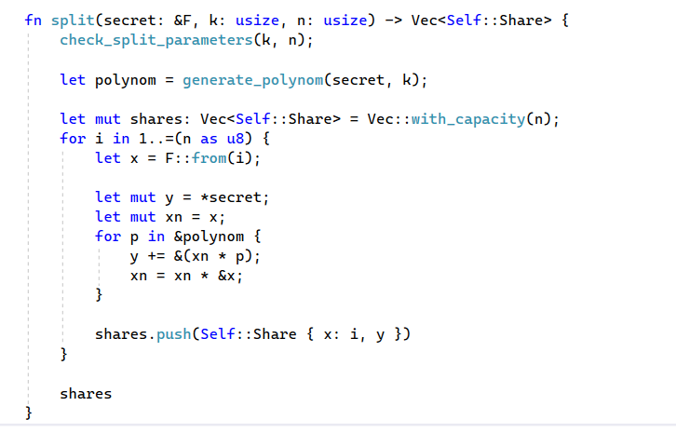
Implementing Shamir's Secret Sharing in Rust

Slide 5
